Slide 1


Subscription Strategy Revamp for Citi Bike Application
Group – 08
Mohit Kumar Dundu-1002011177
Ayvee Nusreen Anika-1002027982
Suchit S Kakirde- 1001837315
Pratik Prashant Phirke-1002021297

Slide 2
Business context & problem Statement
Citi Bike rental Application is a service where people can rent bikes for a certain period. From bike booking to payment options, everything is computer controlled.
Company has recently faced a reduction in their subscriptions during the Covid19 pandemic and decided to give discounted subscriptions to their potential customers.
As part of Citi Bike’s Data Analytics Team, we are providing Insights for the managers to decide the location, time and demographics to rollout the promotion.

Slide 3
Conventional and data driven solution
To tackle this problem, we must answer the 3 W’s.
WHEN?, WHERE?, WHO?
Previously, it was based on instinctual decision of managers.
Annual and semiannual reports.
Our predictive model is based on customer rental data of one year and ready to identify potential customers whom company can provide discounted subscriptions at certain time and place as a part of loyalty program development.

Slide 4
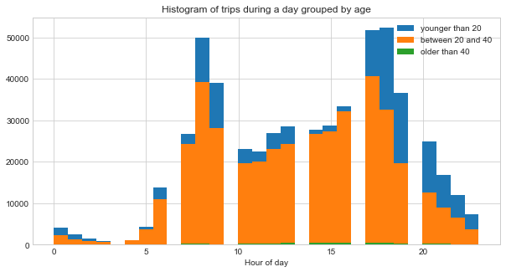
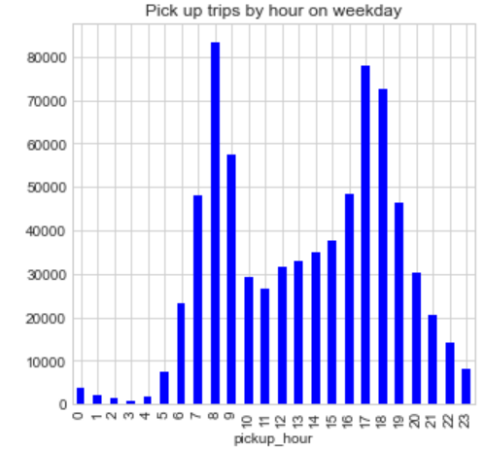
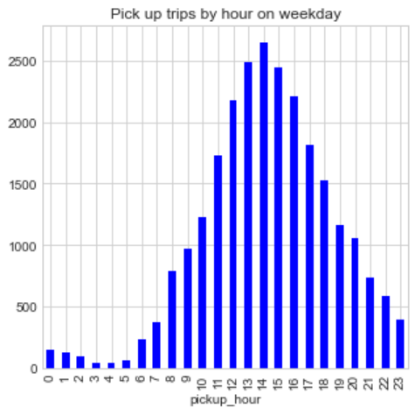
Dataset description & Transformation
List of Variables:
Tripduration, starttime, stoptime, start station id, start station name, start station longitude, start station latitude, end station id, end station name, end station longitude, end station longitude,
Bike ID, usertype, gender, birthdate
Data Transformation:
Start, End Hour extraction from date-time column.
Customer, Subscriber are converted to 0,1 format.
Days are converted to 1-7 from date-time.
Birth Year calculation from provided age.
SUBSCRIBER
CUSTOMER
We can see, on weekdays, there is a dip around 10am and rides increases after 4pm because we suspect these are office hours.

Slide 5
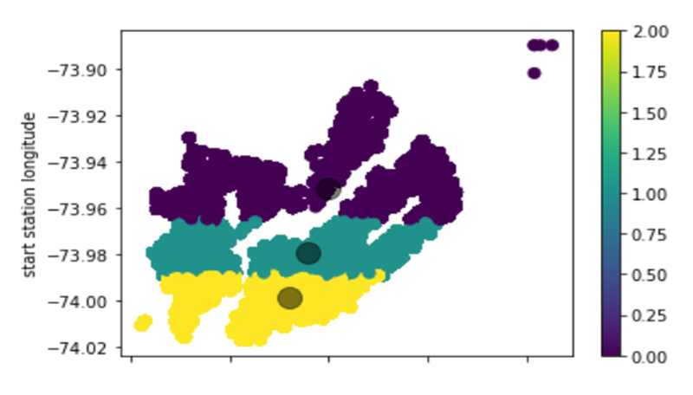
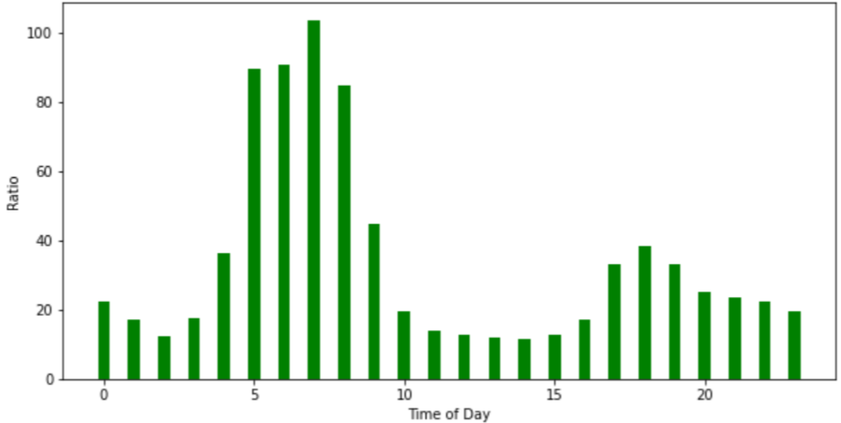
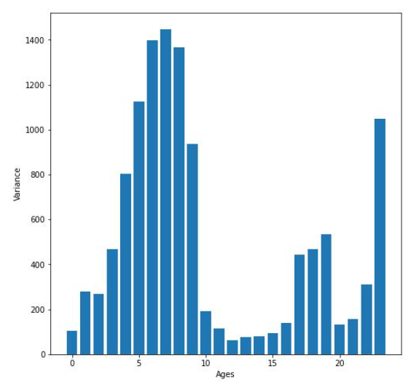
WHERE to provide discounted subscriptions?
Based on latitude and longitude of start stations, the dataset has been segregated into 3 locations using K-Means Clustering.
This Data has been used as a derived variable in the regression model.
WHEN to provide discounted subscriptions?
We calculated ratio of total subscribers to non-subscribers throughout the year. Low ratio means more subscribers compared to nonsubscribers.
Then we find ratio for all the days at a particular hour, where Low Ratio and Low Variance is required
Low ratio indicates higher customer count and low variance indicates lower change in ratio across different days in a year.
WHO to provide discounted subscriptions to?
Using Logistic Regression model, we are identifying potential customers belonging to different demographics.
Results from clustering have been included in the regression model to identify exact locations.
Ratio of total subscribers to total customers throughout the year(for 365 days) at a particular hour.
variance for all the 365 ratios for each hour

Slide 6
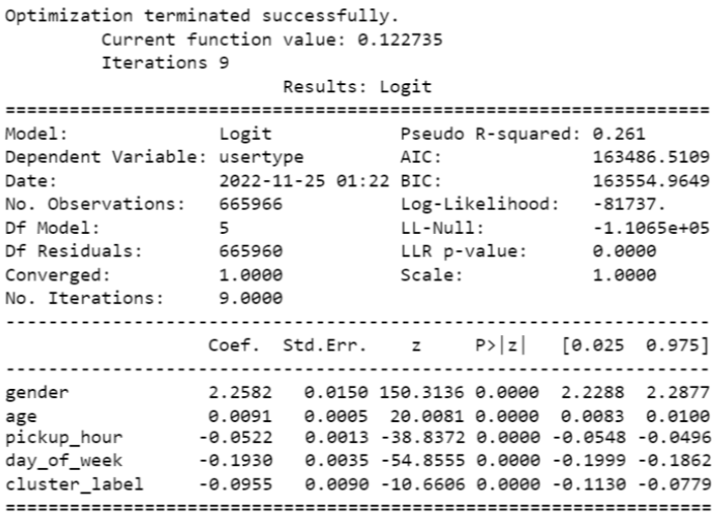
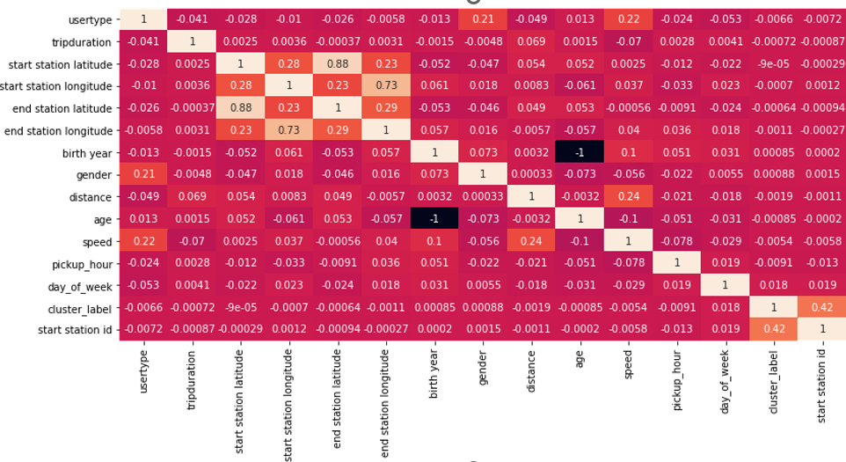
Logistic Regression Model
Correlation Matrix
Based on the data related to user, our model predicts whether a customer can be converted to a subscriber or not. Since the output is a binary variable, prediction using Logistic Regression was best in our case
We see high multicollinearity in our dataset.
To improve the efficiency of the model, we dropped some variables including trip duration, latitude, longitude, birth year(age is present), other string columns and some calculated columns like distance, and speed.

Slide 7
Linear Vs Logistic Regression
In Linear regression, The output variable for user type is beyond 1 (30s, 40s, and even 100s).
Upon putting a cap limit of 0 & 1. we see in Linear Regression the error rate is >10%
Whereas, Logistic Regression, We can see the Error Rate of 0.172 %, where we can see that 1's are getting converted to 0’s.
Thus, we are going forward with Logistic Regression, to achieve better accuracy in the final model.

Slide 8
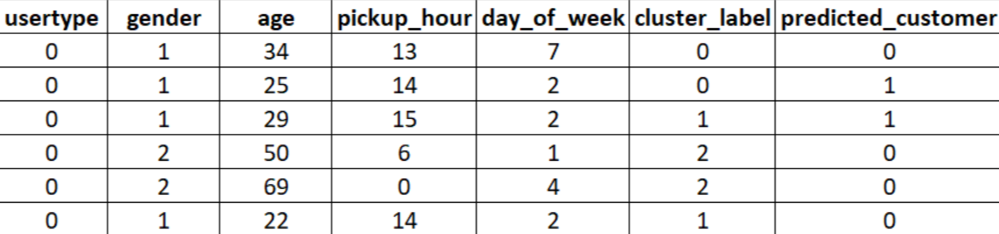
Managerial intuition
During office hours, there will be a greater number of subscribers who are daily users who need the bike rides daily, but they may not may or may not be customers.
Also, in the nonworking hours there might be many customers who need a bike ride.
From above insights we can see that results are indeed surprising because the factors like gender and age are playing a dominant role In predicting whether our customer will be converted or not.
Also, results are surprising based on the timing as it completely overlaps with our ratio and variance model.
SUBSCRIBER
CUSTOMER

Slide 9
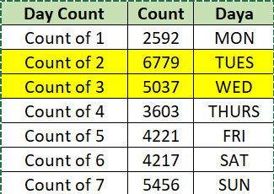
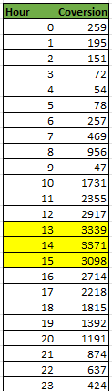



Managerial Insights for providing promotion.
Best Day
Best Time
Total Conversion
Gender Segregation
Cluster Segregation
Top 3 Promotion Locations
Age factor
80% of customers who are born before 1980, and after 2002 are not getting converted. So we tend to target age groups of relatively young people between 25-40.
514-12 Ave & W 40 St
3641-Broadway & W 25 St
3255-8 Ave & W 31 St

